Slide 1
Building Trust and Connection through Empathy
Eastern Region IPMA-HR Training Forum 2022

Slide 2
Hi, friends!

Slide 4
What is Leadership?

Slide 5
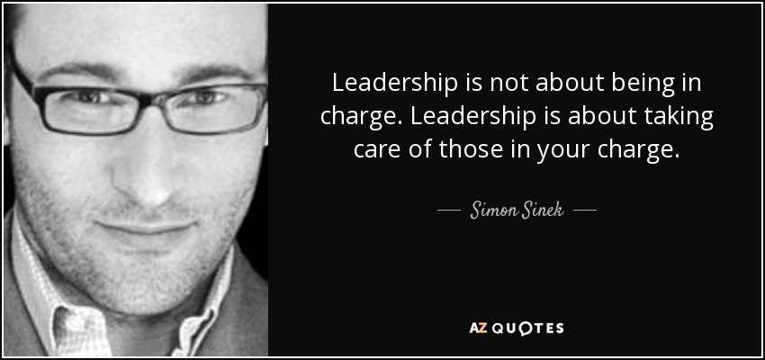
Leadership is not about being in charge.
Leadership is about taking care of those in your charge.
Simon Sinek

Slide 6
Source: Servant Leadership Centre of Canada

Slide 7
Trust is the essence of the public sector.

Slide 8
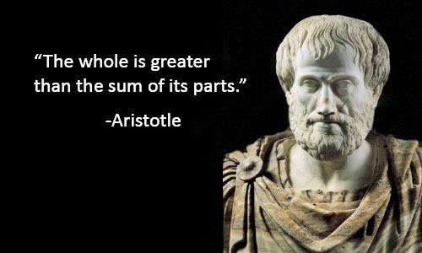
The whole is greater than the sum of its parts.
Aristotle

Slide 9
3 > 1+1+1

Slide 10
3 > 1+1+1
The key is alignment.

Slide 11
Vulnerability, when responded with empathy, cultivates connection and trust.

Slide 12
How do I get it?

Slide 13
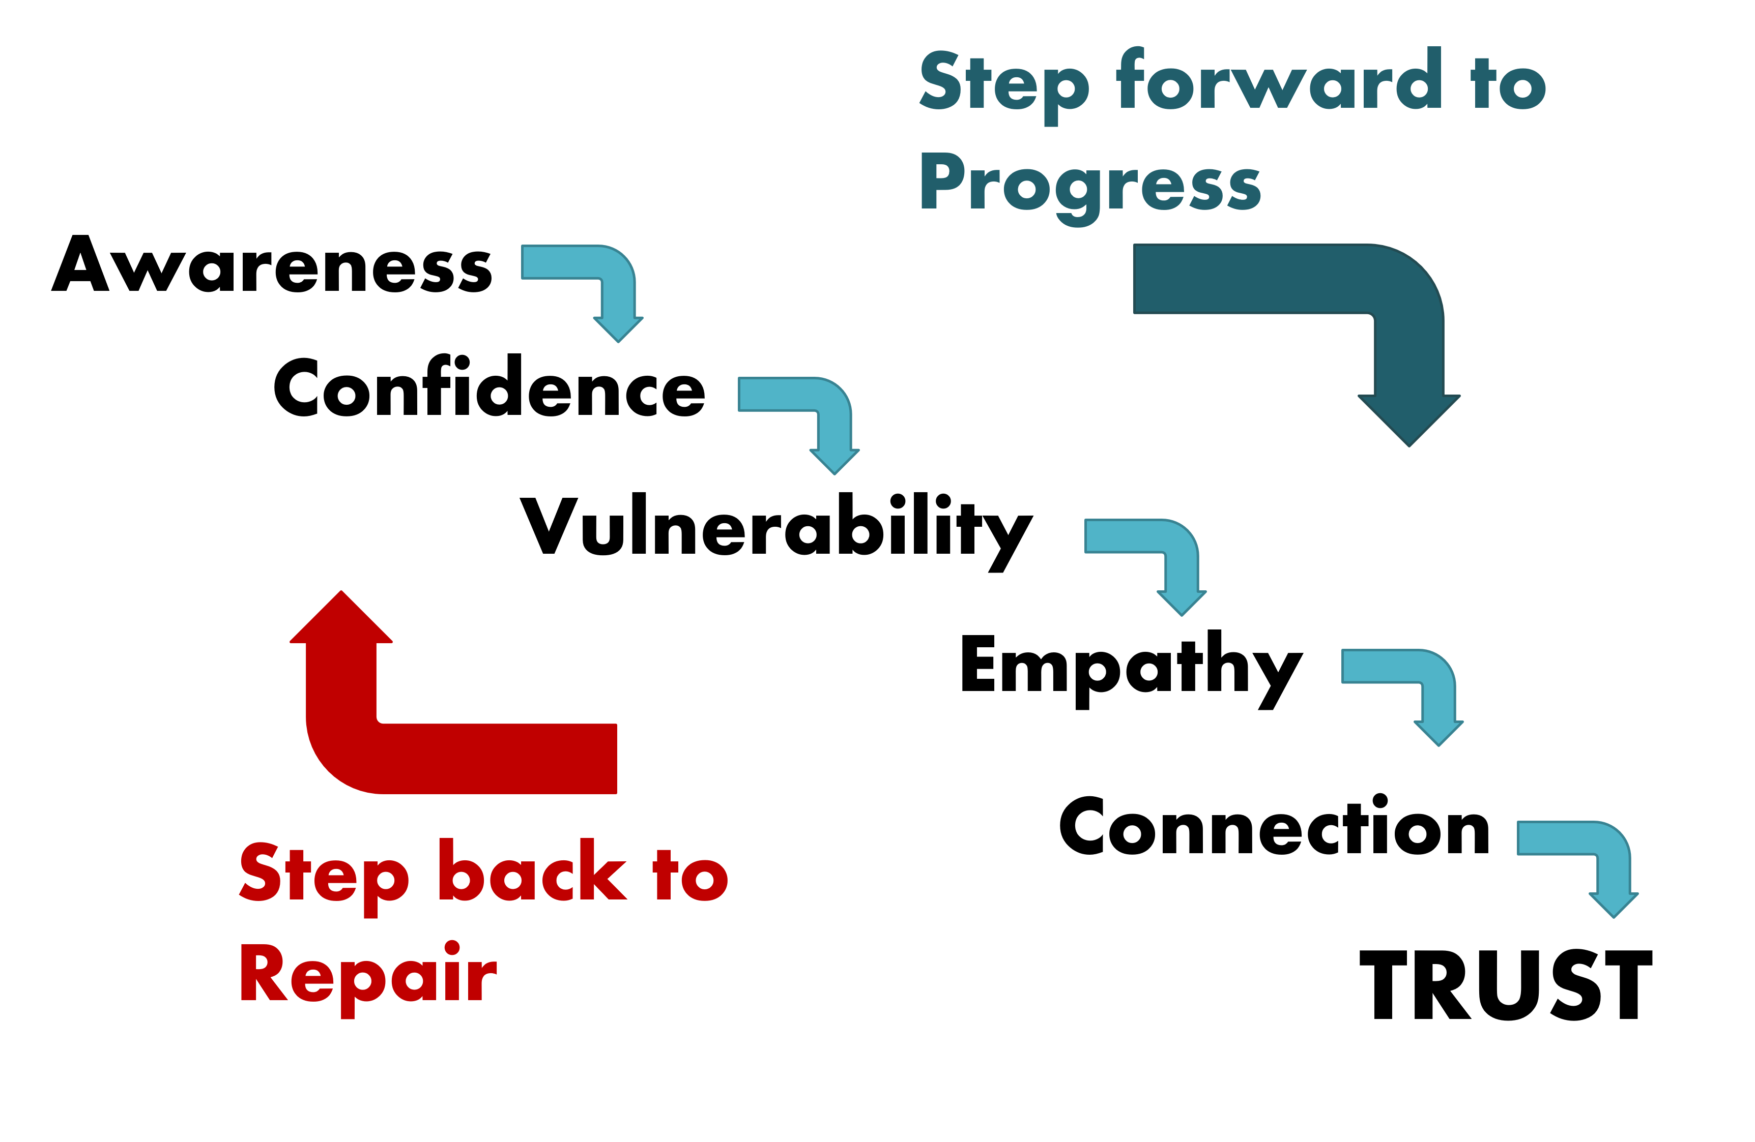
Begins with You
Source: http://www.cecilyk.com/

Slide 14
Self Awareness
Find time to learn about yourself.
- What comes naturally or with practice
- Your preferred way to learn
- Your communication tendencies
- Your “Kryptonite”
Ask trusted peers to help you see your blind spots.

Slide 15
Grows with Confidence
Source: http://www.cecilyk.com/

Slide 16
Confidence in Self
- Know who you are
- Know who you are not
- Know how and when you can contribute
- Know how and when you can benefit from others
- Not afraid to ask for help

Slide 17
Confidence in Environment
Psychological Safety
Psychological Danger
Learning from failure
Everyone openly shares ideas
Better innovation & decision making
Comfort in admitting mistakes
Blaming others
Less likely to share different views
Common Knowledge Effect
Fear of admitting mistakes

Slide 18
Requires Vulnerability
Source: http://www.cecilyk.com/

Slide 19
Expressing Vulnerability
“Owning our story can be hard but not nearly as difficult as spending our lives running from it. Embracing our vulnerabilities is risky but not nearly as dangerous as giving up on love and belonging and joy – the experiences that make us the most vulnerable. Only when we are brave enough to explore the darkness will we discover the infinite power of our light.”

Slide 20
Reflects Empathy
Source: http://www.cecilyk.com/

Slide 21
Empathy sounds like
This:
Ouch.
I would be hurt too.
This must be really hard.
You are not alone.
I’m glad you shared this with me.
Not this:
It’s not that bad.
It could be worse.
At least it’s not...
Don’t feel that way.
Don’t be afraid.
Just look on the bright side.
Chin up.

Slide 22
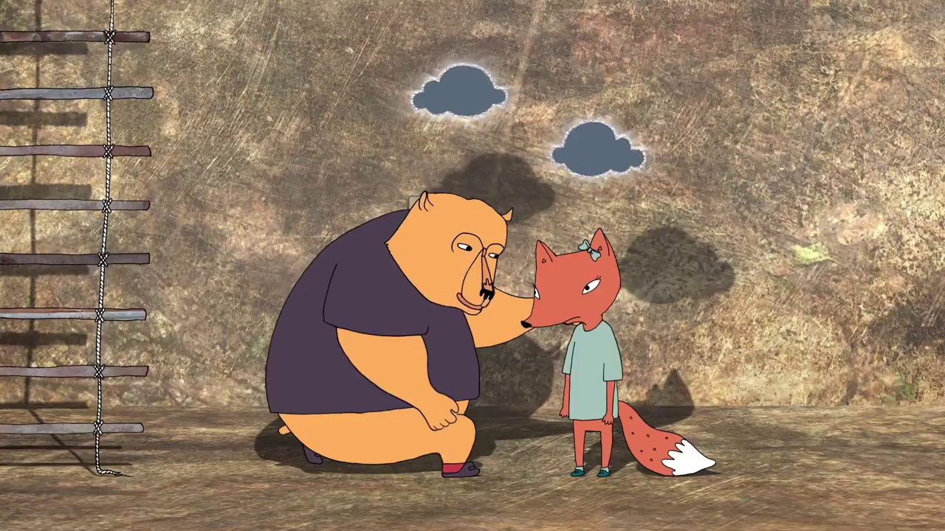
4 Elements of Empathy
1. Perspective taking
2. Staying out of judgement
3. Recognizing emotions in other people
4. Communicating
Source: Brené Brown

Slide 23
Builds Connection
Source: http://www.cecilyk.com/

Slide 24
Power of Connections

Slide 25
Connection Builds Trust
Source: http://www.cecilyk.com/

Slide 26
Vulnerability, when responded with empathy, cultivates connection and trust.

Slide 28
Story Time: Cutting My Son’s Hair

Slide 29
Story Time: Cutting My Son’s Hair

Slide 30
Story Time: Public Safety Compensation

Slide 31
Your Turn!
1. Take out a sheet of paper.
2. Identify 3 strengths and 1 weakness.
3. Share a vulnerable experience with others around you as listeners practice responding with empathy.
4. Note your and others’ reactions.

Slide 32
Observations from Practice

Slide 33
Observations from Practice
Empathy may or may not be natural to some.
Empathy can be learned.
The more you practice, the more you will improve.
Empathy is powerful.

Slide 34
Visual Test

Slide 35
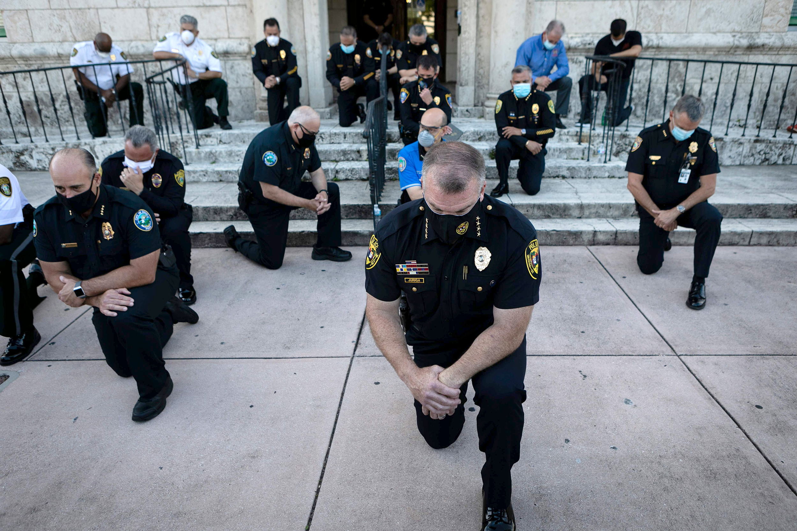
Which officers do you connect with?

Slide 36
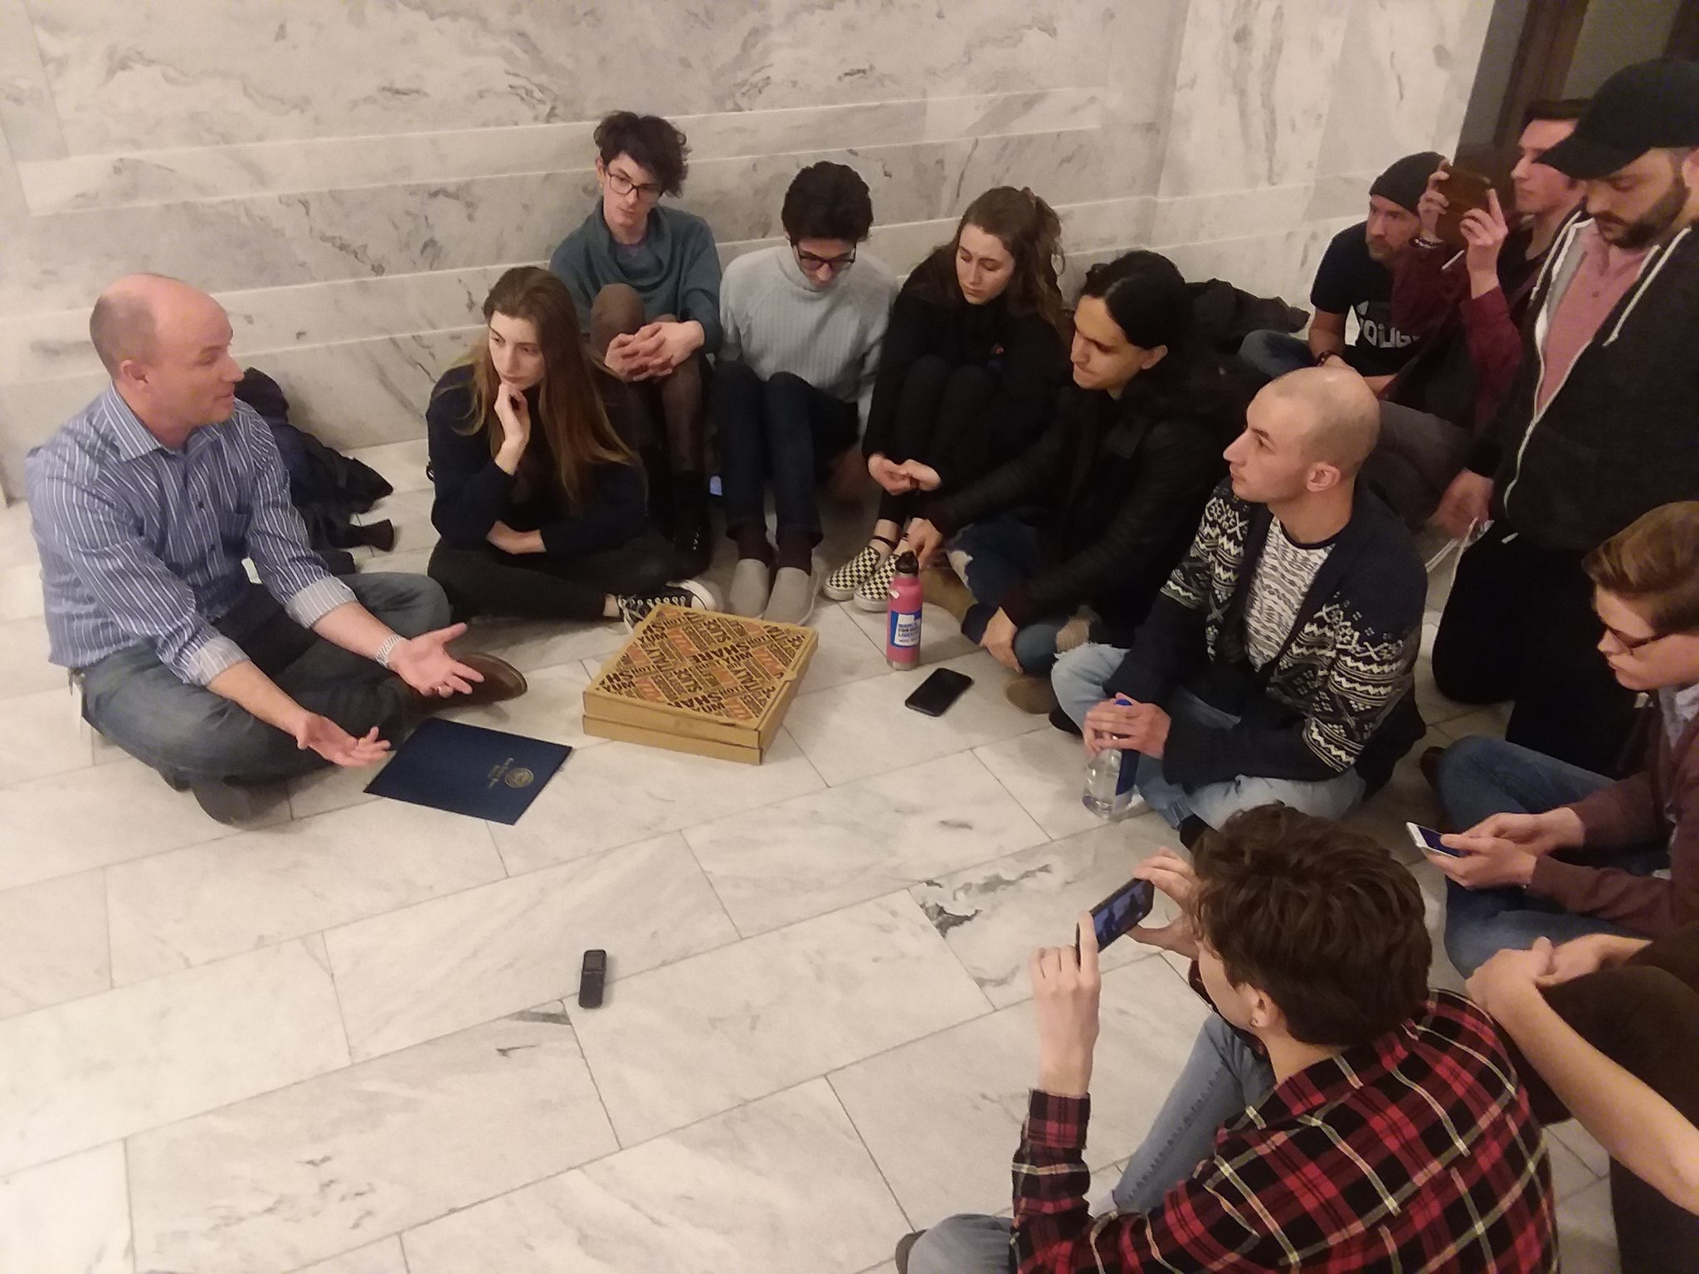
Visual Test
Source: Christina Giardenelli, The Daily Universe

Slide 37
What if it doesn’t work?

Slide 38
Identify Areas of Focus

Slide 39
How do I sustain the effort?

Slide 40
Sustaining Empathetic Leadership
Be intentional, seek out connection
Create a psychological safe environment
Normalize vulnerability
Appreciate, honor, and celebrate
Have grace

Slide 41
Vulnerability, when responded with empathy, cultivates connection and trust.

Slide 42
What could you do with more trust?

Slide 43
A Recruitment Story
66 Applicants for HR Generalist
66 Individual responses
Aug 2021 HR News

Slide 44
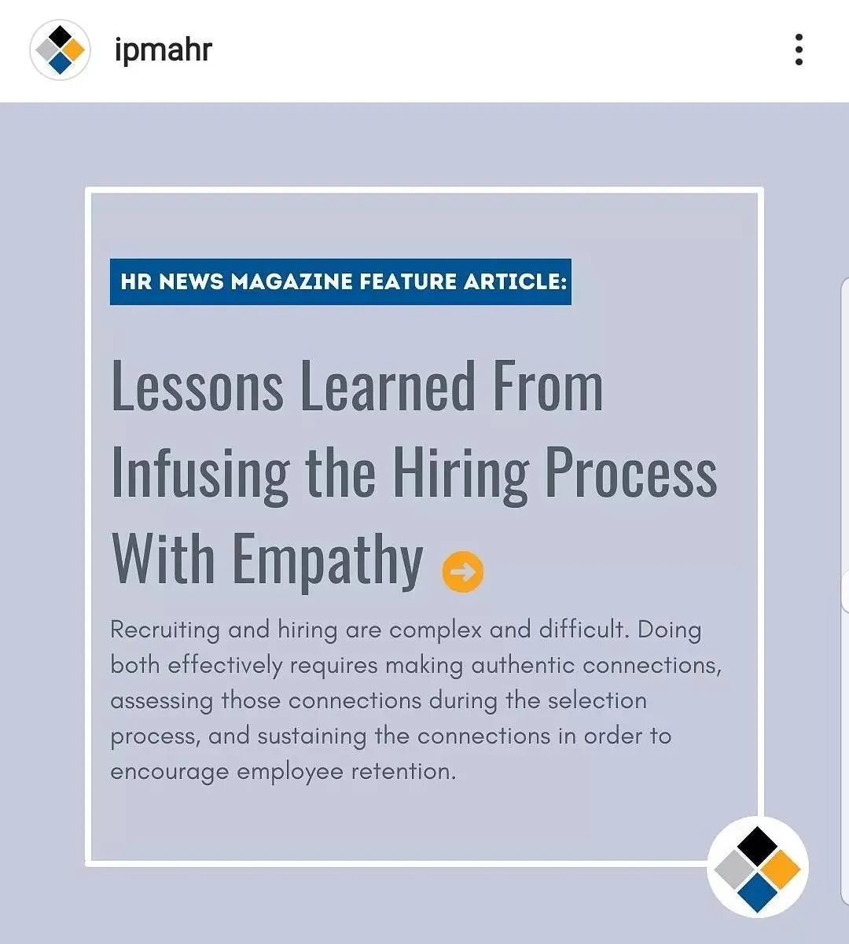
A Recruitment Story

Slide 45
A Favorite Rejection

Slide 46
A Favorite Rejection
Hello NICHOLAS, Thank you for your interest in the Human Resource Generalist position. I am always excited when others want to work in HR (I'm a nerd, I get it--HR is my passion). After reviewing all of the candidates (there were 29), I have decided to interview other candidates. In full transparency, this is the second time I've hired for this position this year. The person I hired in February recently got an internal promotion (BIG kudos to her), so I chose to focus on candidates that will save me the most training time--internal candidates and candidates that had interviewed with me before. I do know of other openings in HR. I sometimes share jobs on LinkedIn or I am happy to share your information with them. You are also welcome to apply for other employment opportunities with Lehi City. Attached is a link to our website where you can view and apply for our latest job openings. Thank you and good luck in your job search. Lehi City Job Link: http://lehiut.applicantpro.com Sincerely,

Slide 47
A Favorite Rejection
“As someone who also has a passion for HR and always looking for opportunities to grow, I must say this is absolutely the best declined email I’ve received. Thank you for approaching it from a human perspective. We’re all humans and all looking for that next opportunity, showing empathy never goes unnoticed, so wanted to express my thanks for your wonderful email.
Never felt so good about not being selected for a position. ☺
I’ll be sure to look you up on LinkedIn and hopefully one day our paths cross. “

Slide 48
A Fond Farwell

Slide 49
A Fond Farwell
“I cannot thank you enough for being my friend. I wish everyone had friends like you.”

Slide 50
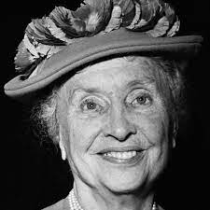
What could you do with more trust?
Alone we can do so little;
Together we can do so much.
Helen Keller

Slide 51
Step forward to Progress
Awareness
Confidence
Vulnerability
Empathy
Connection
Step back to Repair
TRUST

