Slide 1
The Post-Pandemic Employment Landscape
April 26, 2022

Slide 2
From Pandemic to Endemic
Endemic.
Noun or adjective. A disease that is always present in a population within a geographic area.
Souce: Taber’s Cyclopedia Medical Dictionary, 24th Ed. (2021)

Slide 3
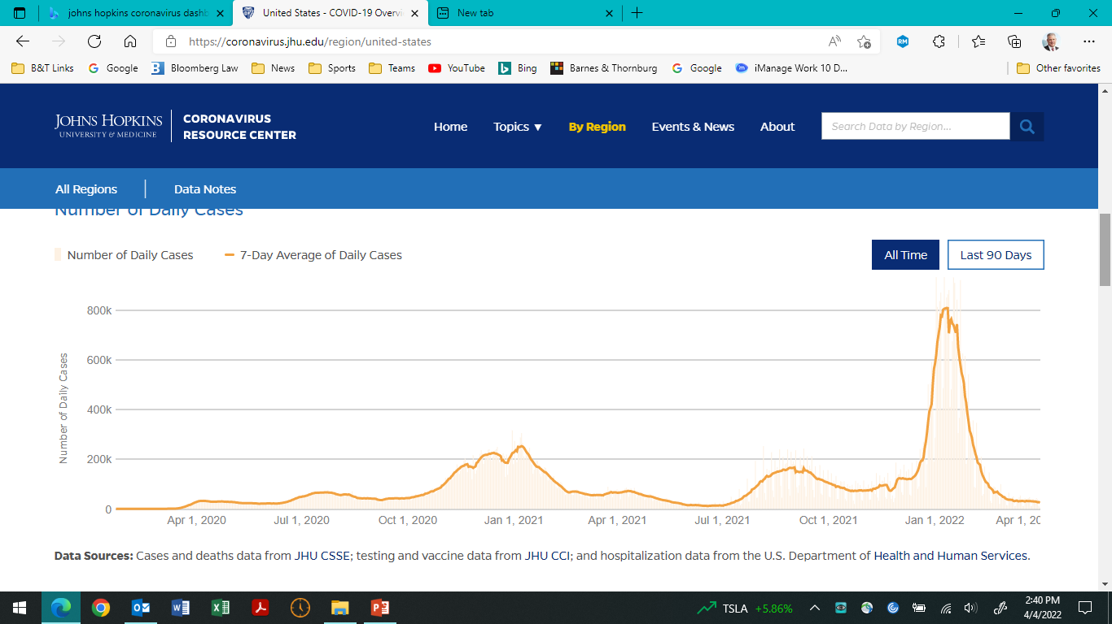
Pandemic by the Numbers
80.16 MM (79.05 MM last webinar )
902,685 past month
4,586 daily v. 1.3 MM Jan 10, 2022
India: 43.02 MM (42.9 MM last webinar).
28 day total – 61,729 MM down from 1.4 MM
Brazil: 30.0 MM (28.7 MM last webinar)
28 day total – 946,260 down from 3.3 MM
Omicron variant (BA.2) now ripping through parts of Asia and still affecting Europe
SK: 9.3 MM last 28 days
Vietnam: 5.3 MM last 28 days
Germany: 5.8 MM last 28 days
France: 2.9 MM last 28 days
UK: 2.1 MM last 28 days
Current toll: 982,675
28 day death toll: 23,004 (down from 61k last month)
Source: Johns Hopkins Coronavirus Resource Center

Slide 4
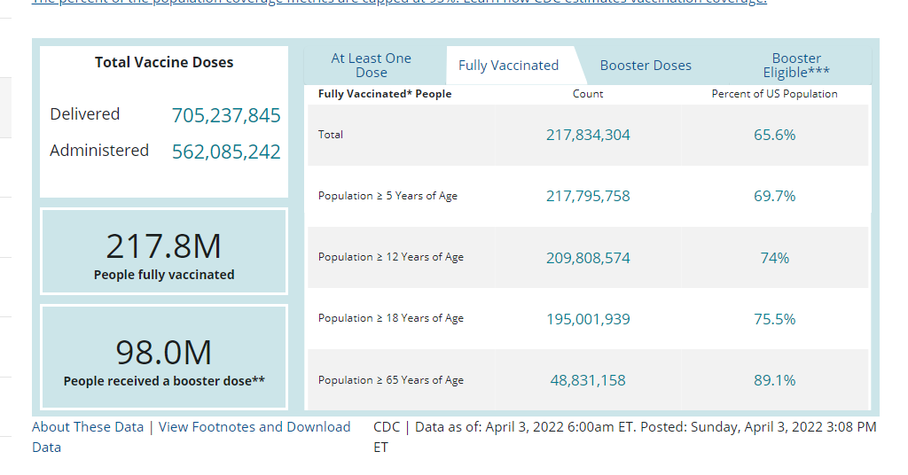
Vaccination stats

Slide 5
Other Notes
Omicron “stealth” variant now the dominant strain in the US (CDC reports BA.2 makes up 72.2% of the variants as of April 2 – up from 57.3% previous week)
Has ability to “immune escape” making it capable of evading neutralizing antibodies
Means capable of infecting vaccinated and previously infected individuals
Symptoms appear to be similar to Omicron
Vaccines remain highly effective at preventing severe illness – but UK still experiencing spike in hospitalizations and deaths due to unvaccinated populations
Mask mandates/shutdowns unlikely to resurface
Number of companies dropping vax mandates (Starbucks, Intel)
# of large employers still maintaining vax mandates (United Airlines, Nike, Tyson Foods)
Others taking hybrid approach – vax’d employees not subject to mask mandates
Federal mask requirements on airlines struck down on April 18th

Slide 6
OSHA’s Response
OSHA’s COVID-19 Vaccination and Testing ETS (for Employers of 100 or more Employees) – was formally withdrawn on 1/26/22
OSHA noted – “Although OSHA is withdrawing the vaccination and testing ETS as an enforceable emergency temporary standard, the agency is not withdrawing the ETS as a proposed rule.” Working towards healthcare standard
Healthcare ETS – adopted 6/21/21 and “withdrew” the non-recordkeeping portions of rule on 12/27/21
Still working towards “permanent regulatory solution”
In the meantime, compliance with Healthcare ETS would satisfy General Duty Clause obligation

Slide 7
OSHA COVID-19 Obligations for Non-Healthcare Employers
Now what? No Vaccine or Test Mandate – What does OSHA expect from non-healthcare employers?
OSHA’s Guidance on Mitigating and Preventing the Spread of COVID-19 – https://www.osha.gov/coronavirus/safework (unchanged since 8/13/21)
Facilitate vaccinations (i.e. give time off for vaccinations)
Instruct employees to stay home if sick (showing symptoms) or close contact (if unvaccinated)
Face coverings – even if vaccinated wear them indoors in areas of “substantial or high transmission”

Slide 8
CDC’s Change from Transmission Rates to Community Levels
Previously CDC tracked COVID-19 transmission rates (Low, Moderate, Substantial and High)
When this was first changed in Feb. nearly the entire US was “high or substantial’ under old test

Slide 9
New CDC Community Levels (Eff. 2/25/22)
CDC looks at the combination of three metrics –
New COVID-19 admissions per 100,000 population in the past 7 days,
The percent of staffed inpatient beds occupied by COVID-19 patients, and
Total new COVID-19 cases per 100,000 population in the past 7 days – to determine the COVID-19 community level.
Cutoff now is <200 cases/100,000 people and ≥200 cases.
Previously – anything more than 100 cases/100,000 people – “high”
Now 3 levels – Low / Medium / High
Old Community Transmission levels for “healthcare facility use” only
Only at “High” level is a mask recommended for indoor settings

Slide 10
Comparison of CDC Standards (3/31/22)
Old CDC Transmission Std.
New CDC Community Std.

Slide 11
CDC Recommendations – 2nd Booster
3/29/22 – CDC announced that they have adopted FDA recommendations that certain immunocompromised individuals (i.e., cancer, stem cell transplant patients, HIV, etc.) and anyone 50 years or older who received an initial booster more than 4 mos. ago is eligible for another booster shot
The booster must be an mRNA vaccine (Pfizer or Moderna) regardless of the original shots (i.e., J&J)
Quarantine – CDC’s “up to date” with vaccinations only refers to 1st booster at this time. Quarantine for 5 days if not “up to date” with vaccinations. If “up to date” do not have to quarantine unless develop symptoms

Slide 12
Masking Requirement
The OSHA “Guidance” from 8/13/21 remains unchanged. It still references wearing masks in indoor settings regardless of vaccination status in “areas of substantial or high community transmission” (hyperlinked to CDC)
However, CDC changed that hyperlinked page to point to the COVID-19 Integrated County View with the (High/Medium/Low) level ratings which has effectively changed what OSHA is requiring. Almost no “high” rating anywhere
Many companies have eliminated mask mandates pointing to the new CDC ratings for monitoring the pandemic showing that they are in a “Low” rated area that would not require masking in indoor settings
Many states are lifting mask mandates both in public and in schools: CA, CT, DE, HI, IL, MD, MA, NV, NM, NY, OR, PA, RI, VA, WA

Slide 13
Other OSHA Requirements
Daily Health Questionnaires – this is not technically required by OSHA guidance. Simply having a policy in place stating that employees should stay home if they are suffering from COVID-19 symptoms (and enforcing it, if employees come to work sick) is sufficient

Slide 14
Employee Behaviors: What to do and How to react
Increases in claims of “systemic” and more subtle discrimination
Microaggression: a comment or action that subtly and often unconsciously or unintentionally expresses a prejudiced attitude toward a member of a marginalized group (such as a racial minority. Investigators must check personal biases and look for patterns and repeats – not just stray remarks
Three types:
Microassaults (overt epithets, use of symbols)
Microinsults (verbal or conduct such as avoidance, interruptions, hidden meanings)
Microinvalidations (make hearer feel “less than,” such as “where are you from?”)

Slide 15
Mental Health
Increasing manifestation of mental health impacts of pandemic:
Half of US adults report negative mental health impacts from pandemic, with greatest concentrations of impact reported among women, young adults (ages 18-29), and Black adults (Source: Kaiser Family Foundation)
Impacts include fear, sadness, withdrawal, irritability, anxiety, low self-esteem, worthlessness, guilt, self-hatred, changes in behavior, sleep patterns and eating habits, erratic behaviors including harm to self and others (Source: American Psychological Association)
68% of employers report introducing at least one new wellness benefit to employees during pandemic (Source: Gartner)

Slide 16
Societal Impact
Societal disintegration spilling into the workplace:
Political tribalism creates and inflames animosities and is a filter investigators must understand in determining facts and credibility
Political bias impacts factual perception: Democrats and Republicans simply view the same facts, circumstances and social issues differently*
Political engagement is up 20%, and 74% of employees expect employers to be more involved in political and cultural issues (Source: Gartner)
*Source: Alesina, A., Miano, A. and Stantcheva, S. (2020) “The Polarization of Reality.” American Economic Association Papers and Proceedings, v. 111

Slide 17
Societal Impact
Societal disintegration spilling into the workplace:
Cancel culture. When persons use social media or personal accounts to exert control over another person through negative digital feedback, boycotting, demonetizing or deplatforming
Employees can and do attempt to “cancel” their employer, their employer’s customers or business partners
Cancellation is legally unregulated behavior that can be costly and irreversible
Employers may prohibit “cancellation” activities through enforceable social media & bullying policies, code of conduct, restrictive covenants (as allowable by law)
*Source: Alesina, A., Miano, A. and Stantcheva, S. (2020) “The Polarization of Reality.” American Economic Association Papers and Proceedings, v. 111

Slide 18
Societal Impact
Hate Speech
Speech expressing hatred of a particular group of people
First Amendment does not generally apply: private employers can regulate all speech at work and offsite
Exception: speech pursuing civil rights or bargaining
Hate speech can be any verbal, written or behavioral communication based on protected characteristics or status that communicates:
Threats and intimidation
Pejorative, degrading, humiliating or discriminatory messaging
Harassment severe enough to create a hostile work environment
Messaging that incites hatred against persons of a protected characteristic or status
Messaging that damages the employer, customer or community
Communications defined as hate speech by applicable laws

Slide 19
Strategies to Steer a Responsive Culture
Enhance programs and resources for mental well-being, remember that work has become a surrogate for other family/community bonds interrupted in the pandemic
Consider ombudsperson as a first responder to situations that may be de-escalated
Revise and enforce anti-discrimination, anti-harassment, social media, bullying, and other behavioral policies to set expectations for microaggressions, divisive speech, cancel culture
Train your investigators to: (i) use policies as their guide star for consistent investigations and outcomes, (ii) work through biases in themselves and others, (iii) deescalate workplace provocations, and (iv) identify widespread or systemic policy violations or vulnerabilities
Convene regular, privileged consultations with investigations and benefits/accommodations personnel to (i) monitor trends in complaints, (ii) identify hot spots of employee needs, (iii) improve investigations, benefits and accommodations processes, and (iv) blunt risks
Manage upward through regular, privileged leadership consultations on high risk or other “teachable” matters
Get a seat at the table (and a voice!) in corporate communications, public relations, DEI initiatives and communications

Slide 20
“House on Fire” Strategies
Develop and communicate an escalation protocol for when in house or outside counsel should be brought in to consult on specific complaints and investigations
Prepare and obtain leadership buy-in for an investigations protocol for outsourcing investigations: (i) at and above a specific level of managements; (ii) involving certain types or levels of allegations, or (iii) involving repeat players or clusters of concerns

Slide 21
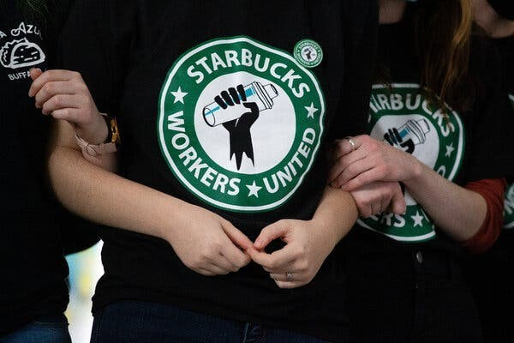
Recent Employee Relations Developments in the Headlines
Starbucks
184 union representation petitions filed since 2021
170 petitions filed in 2022
5 elections held – unions have won all 5 elections conducted

Slide 22
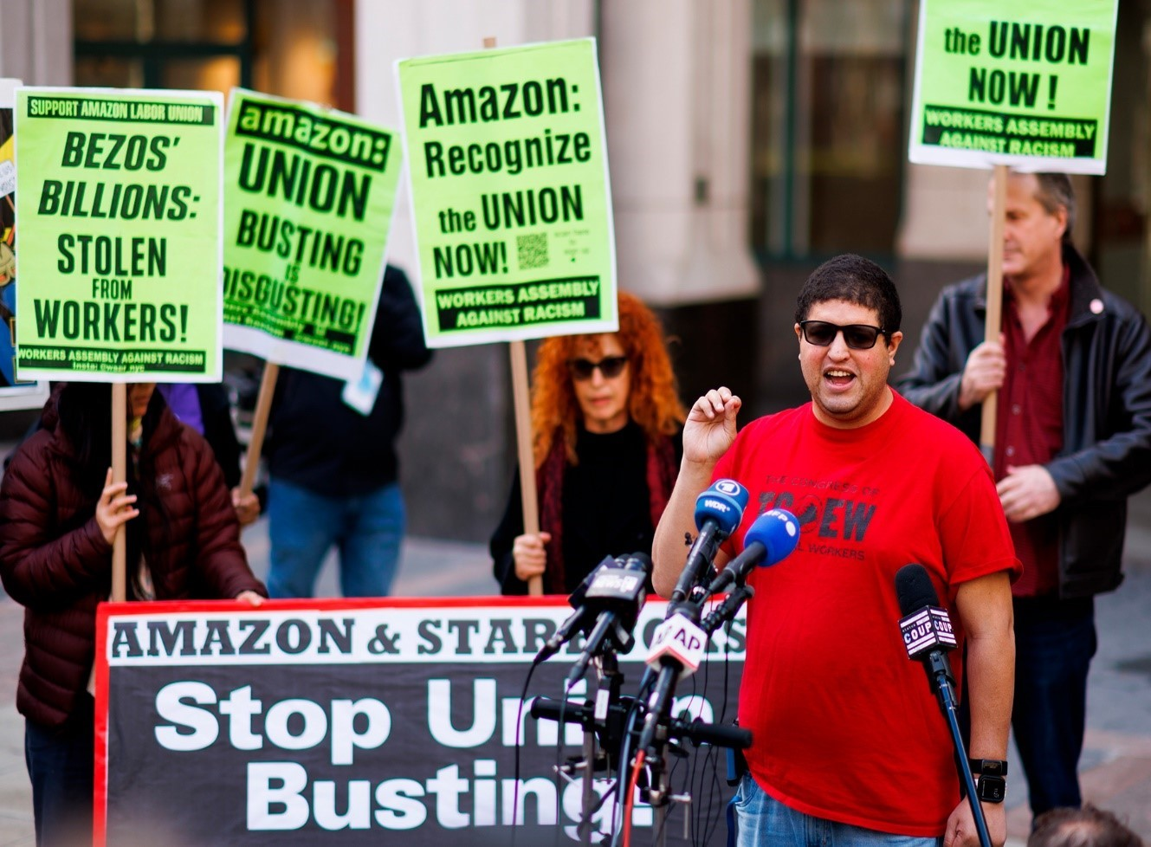
AMAZON
Two elections conducted on 4/1/22
Staten Island – union prevailed in election 2,654 to 2,131 victory
Gives Christian Smalls’ union right to negotiate a contract with Amazon for the roughly 8,000 workers at the Staten Island warehouse.
Smalls was fired by Amazon in 2020 on claimed violations of quarantine rules.
Leaked memo: “He is not smart, or articulate and to the extent the press wants to focus on us versus him, we will be in a much stronger PR position than simply explaining for the umpteenth time how we're trying to protect workers.“
Bessemer – 2nd vote – Amazon leading 993 to 875
400 challenged ballots

Slide 23
The “Great Resignation”
Wave 1 – November, 2021 – record 4.5 MM resignations
January, 2022: 4.3 MM resignations
February, 2022: 4.4 MM resignations
Record number of job openings (11.3 MM in February, 2022)
Layoffs at near record lows

Slide 24
What is Fueling the Great Resignation?
Backlog of resignations from 2020
“Burnover” – heightened turnover across all sectors due to worker burnout
“Pandemic epiphanies” – major life shifts among workers due to pandemic experience
Remote work experience and expectations
Dr. Anthony Klotz
Texas A&M University

Slide 25
Ongoing Labor Impacts of the Great Resignation
More than “missed quits” carried over from 2020 lockdowns, the Great Resignation:
Is a persistent phenomenon aligning with trajectory of the COVID-19 pandemic/endemic
4.5 million quits in November 2021, a new record (SHRM)
25% job quits in 2021, expected 23% in 2022
Impacts all sectors, particularly food, lodging, retail and recreation sectors
Mid-career workers and female workers more likely to quit

Slide 26
Statistically Significant Drivers of U.S. Unemployment During the Great Resignation
Contracted COVID-19
Fear of contracting COVID-19
Pandemic-related child care
No longer desire to re-enter workforce
U.S. Census Bureau
Week 40 Household Pulse Survey

Slide 27
How Does the Great Resignation Play Out in year 3 of the Pandemic?
Burnover – will manifest at all levels of your organization and available talent pools
Pandemic Epiphanies – impacts how workers view opportunities
Changing risk/benefit analyses of health, public safety and climatic concerns, and personal expenses, associated with traditional workplaces and commutes
Primacy of protecting family health
Successful pandemic remote working experience
Successful pandemic self-employment or “gig” employment
Reassessment of interest in participating in workforce

Slide 28
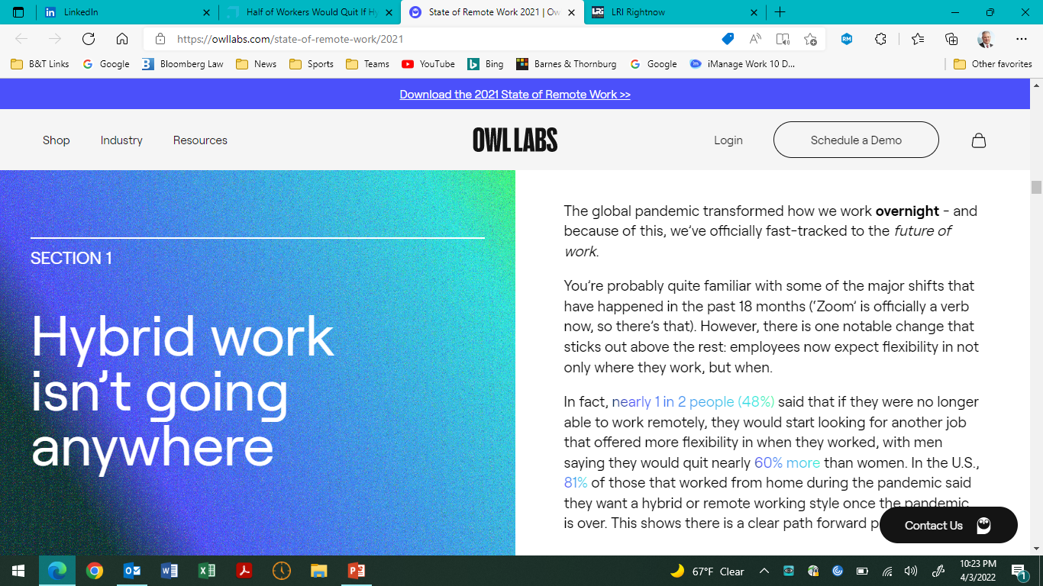
The rising tension with employers demanding full return to work
Microsoft (UK study) Dec. 2021
51% would leave jobs if hybrid work option removed
50% willing to take 5% pay cut to keep working at home
US Studies reflect similar resistance
HR Experts: “employees are calling the shots”

Slide 29
So what are employers doing?
Alphabet (Google): Employees will need to work from the office for at least three days a week beginning on April 4
Apple: On April 11, employees ill have to work from the office at least one day a week. That jumps to three days per week on April 23
Meta (Facebook): The company says employees will need to be back at work on March 28, unless they request a deferral before mid-March
Microsoft: By March 28, employees will have to move to a hybrid work model agreed with their individual managers

Slide 30
Strategies for Employers: No More “This is the Way We’ve Always Done It”
Hiring managers that blame outside factors and do not offer flexible work arrangements will be the “losers who struggle in the wake of the Great Resignation…”
Dr. Anthony Klotz
Texas A&M University

Slide 31
Employer Strategies: Assess the Work You Need Short Term and Long Term
Review your org charts
What positions do you need filled, and when?
Can functions be combined, or divided, among jobs?
With or without a pandemic, what functions can be performed remotely or in a hybrid remote and on-site environment?
What functions can be performed by temporary staffing or independent contractors?
Review your physical plant needs and commitments
How and where is your physical footprint configured?
Can you contract or expand, and in what timeframe?
Can you create shared workspaces, hoteling, or open environments to make your spend on footprint more efficient?

Slide 32
Employer Strategies: Adapt Practices to Address Pandemic Epiphanies and Burnover
Enhance branding as a culture supporting and providing community to workers
Communicate enduring commitment to worker and workplace, safety, and that policies may be subject to change based on emerging public health developments
Amp up training of HR and other leaders in recognizing biases and corrosive behaviors, and in objectively managing workplace conflict consistently
Update harassment, bullying and social media policies and enforcement practices
Review and update accommodations policies and practices to create a consistent, enduring approach that maximizes opportunities for interactive processes
Celebrate employee hiring, retention and voluntary separation, to create long term brand ambassadors

Slide 33
Discussion
What are organizations doing with in-person return to work plans and why?
Rebuilding culture and civility after two years of remote work
Combatting worker discontent in the post-pandemic era
Measuring employee engagement/culture particularly with remote/hybrid work
Big Picture and Lessons learned

Slide 36
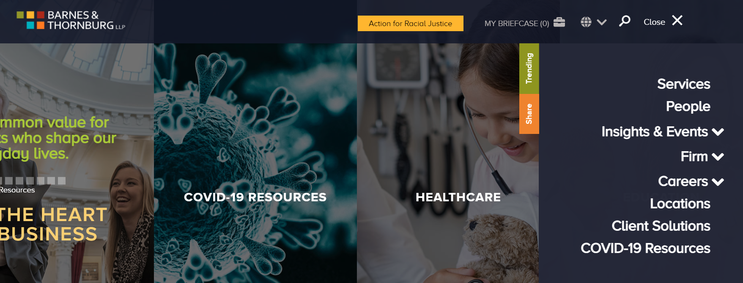
Subscription Center
Update your subscription
Visit the Insights & Events link that sits on the homepage of btlaw.com and on the bottom of the page you can select our subscription center to update your preferences.

Slide 37
COVID-19 Resources at B&T
Visit our Resources Page
Visit the link that sits on the homepage of btlaw.com to get updated information about how the firm is supporting its clients during the pandemic.

Slide 38
ACKNOWLEDGMENT & DISCLAIMER
These materials were prepared by the attorneys at the law firm of Barnes & Thornburg LLP. These materials present general information about state law and federal law, and they only serve as a beginning point for further investigation and study of the law relating to these topics. Although these materials present and discuss labor and employment law issues, they are not intended to provide legal advice. Legal advice may be given and relied upon only on the basis of specific facts presented by a client to an attorney. Barnes & Thornburg LLP and the authors of these materials hereby disclaim any liability which may result from reliance on the information contained in these materials.

